Slide 1



SMART INDIA HACKATHON 2026
IDEA SUBMISSION
VALIDRA
Evidence-first AI compliance engine for packaged commodities
Problem Statement ID | 26034
Problem Statement Title | Software System to check compliance of Packaged Commodities under Legal Metrology (Packaged Commodities) Rules, 2011 by scanning products, images and labels
Theme | Miscellaneous
PS Category | Software
Team Name | VisionMinds

Slide 2



IDEA / PROPOSED SOLUTION
VisionMinds
THE PROBLEM WE SOLVE
UNIQUENESS & INNOVATION
Separation of decision & language - Rule engine decides; LLM only explains - no hallucinated legal verdicts.
Confidence-aware pipeline - OCR > extraction > validation confidence propagated; low = NEEDS REVIEW.
Legal RAG with citations - Every finding carries the retrieved provision of the Act / Rules.
Versioned rule repository - Rules carry effective dates; packs judged by law at inspection date.
Evidence-grade audit trail - Immutable records, bounding-box evidence and audit logs.
COMPLIANCE CHECKS PERFORMED
Every packaged commodity must carry mandatory declarations - manufacturer/packer, net quantity, MRP, dates, consumer-care.
Manual enforcement is slow and unscalable across millions of SKUs in retail and e-commerce.
Common violations: missing declarations, wrong MRP format, undersized fonts, improper placement.
MRP Net Quantity Manufacturer / Packer
Mfg & Expiry Dates Consumer Care
Country of Origin Font Size (mm)
Placement Unit Sale Price Readability
OUR SOLUTION - VALIDRA
AI extracts > rules decide > RAG explains > humans review
1
2
3
4
5
6
SCAN Upload or capture label images; originals kept as tamper-evident evidence.
EXTRACT OpenCV preprocessing + OCR with bounding boxes localise every declaration.
VALIDATE Versioned rule engine checks presence, correctness, format, placement, font size.
EXPLAIN RAG over the Act & Rules attaches the exact legal provision to each finding.
REPORT PDF + editable reports with cropped evidence, confidence and rule references.
REVIEW Searchable inspection history and enforcement dashboard with RBAC.
BEYOND THE PROBLEM STATEMENT
E-commerce listing crawler - validate online product pages at scale.
Bulk batch mode - inspect an entire consignment in a single job.
Consumer-facing check - shoppers verify packs and report violations.
Rule-as-config - amendments ship as new rule versions, no redeploy.
DECISION STATES
_{COMPLIANT} Declaration present and passes validation at high confidence.
NON-COMPLIANT
Declaration missing or invalid; severity classified and cited.
NEEDS REVIEW
Extraction confidence below threshold; routed to a human officer.
OPEN SOURCE
EXPLAINABLE
EVIDENCE-GRADE
FIELD-READY
Zero per-scan licence cost
Every verdict cites the law
Immutable audit trail
Web + mobile capture

Slide 3
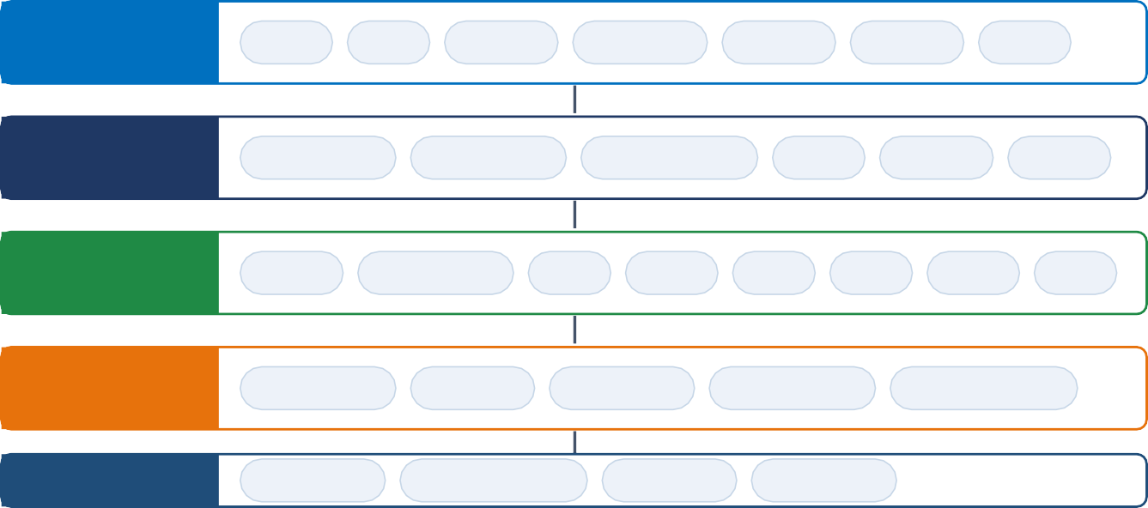
TECHNICAL APPROACH
VisionMinds
PROCESSING PIPELINE
COMPLIANT
COMPLIANT
Product Image
Preprocessing
OCR + CV
Extraction
Rule Engine
Decision
Evidence · Report · Dashboard
Product Image
Preprocessing
OCR + CV
Extraction
NON-COMPLIANT
NON-COMPLIANT
Decision
NEEDS REVIEW
SYSTEM DESIGN / ARCHITECTURE
TECHNOLOGY STACK
Frontend Next.js · TypeScript · Tailwind · shadcn/ui
Backend FastAPI · Python · async REST · OpenAPI Computer Vision OpenCV - preprocessing, perspective fix OCR PaddleOCR - text, boxes, token confidence
ML / NLP spaCy · scikit-learn - field extraction
Rule Engine Versioned repository with legal references
RAG Vector store over Act & Rules + LLM explainer
Database PostgreSQL - inspections, rules, audit logs
Reports ReportLab - PDF compliance reports
Security JWT auth · role-based access · audit trail
FRONTEND
Next.js
Login
Scan
Results
Dashboard
History
Reports
Admin
REST / JSON
BACKEND
FastAPI
Auth / RBAC
API Gateway
Orchestration
Files
Reports
DB Ops
AI LAYER CV + NLP
OpenCV
Text Detect
OCR
Boxes
MRP
Qty
Dates
Care
COMPLIANCE
Rules + RAG
Rule Engine
Severity
Confidence
Vector Store
Legal Citation
DATA
PostgreSQL
Object Storage
Vector DB
Audit Logs
IMPLEMENTATION METHODOLOGY - 6 PHASES
01
02
03
04
05
06
1
Foundation
0
2
Core AI Pipeline
0
3
Compliance Intel
0
4
Legal RAG
0
5
Productization
0
6
Validation
Repo, Next.js + FastAPI skeleton, PostgreSQL schema, auth & API contracts
Upload API, OpenCV preprocessing, OCR with boxes, field extractors
Rule repository & evaluator, violation classes, confidence propagation
Ingest Act & Rules, chunk & embed, retrieval, contextual explanation
Dashboard, history, PDF reports, RBAC and audit logging
Benchmarking, E2E tests, security audit, deployment & SIH demo

Slide 4
FEASIBILITY AND VIABILITY
VisionMinds
FEASIBILITY OF THE IDEA
CHALLENGES & MITIGATION STRATEGIES
TECHNICAL FEASIBILITY
!
OCR degradation on real packs
Built on mature, production-proven open source: OpenCV, PaddleOCR, spaCy, FastAPI, PostgreSQL, Next.js.
No novel model research needed - innovation sits in the rule engine, calibration and evidence layer.
Font-size checks reduce to measurable geometry once pixel-to-mm calibration is fixed.
RISK Glare, curved surfaces, reflective foil and multilingual typography reduce OCR accuracy.
MITIGATION Multi-stage defence: adaptive preprocessing (deskew, perspective correction, glare suppression), multi-engine OCR with agreement voting, confidence gate routing weak reads to human review.
OPERATIONAL FEASIBILITY
!
Font-size measurement in mm
Mirrors the officer's workflow: inspect > record > report. No behavioural re-training.
Web-first with mobile capture - runs on hardware field officers already carry.
Rules are configuration, so departments update them without engineering effort.
RISK Rules prescribe physical sizes, but images only give pixels.
MITIGATION Reference-based calibration: derive scale from known references such as barcode module width, report with a tolerance band, flag borderline cases as NEEDS REVIEW.
!
Legal ambiguity and amendments
ECONOMIC & LEGAL FEASIBILITY
RISK Rules are category-specific, exemption-heavy and periodically amended.
Open-source stack, on-premise deployment: no per-scan licence cost, full data sovereignty.
Positioned as decision support - final legal judgement stays with the authorised officer.
Audit logs and immutable evidence align with enforcement record-keeping requirements.
MITIGATION Versioned rule repository: every rule carries code, category scope, severity, legal reference and effective date. Amendments ship as new rule versions.
!
Trust & admissibility of AI output
RISK Enforcement action cannot rest on an opaque model verdict.
MITIGATION Explainability by construction: the LLM never decides, it only cites. Each finding exposes extracted value, bounding-box evidence, confidence score and exact provision.

Slide 5
IMPACT AND BENEFITS
VisionMinds
TARGET AUDIENCE & IMPACT
BENEFIT ANALYSIS
LEGAL METROLOGY ENFORCEMENT
SOCIAL BENEFITS
First-pass inspection automated - officer time shifts to acting on flagged exceptions.
Consistent, repeatable verdicts across officers, districts and product categories.
Evidence-backed reports generated at inspection time, not reconstructed afterwards.
Transparent, verifiable pricing and quantity at the point of sale.
Greater consumer trust in packaged goods and in enforcement itself.
Accessible reporting lets citizens join market surveillance.
CONSUMERS
ECONOMIC BENEFITS
Faster detection of missing MRP, wrong net quantity and unreadable declarations.
Stronger protection against unfair trade practice and misleading packaging.
Optional consumer check-and-report channel feeds field intelligence back.
Sharp reduction in inspection cost per product versus manual checking.
Higher enforcement throughput without proportional headcount growth.
Reduced litigation risk - findings arrive with evidence and citations.
INDUSTRY & E-COMMERCE
ENVIRONMENTAL & SYSTEMIC BENEFITS
Manufacturers and platforms can self-audit artwork before print or listing.
Fewer recalls, seizures and penalties through pre-emptive compliance checks.
A level playing field for compliant brands competing against non-compliant sellers.
Paperless inspections replace printed forms and physical files.
Fewer reprints and recalls of non-compliant packaging artwork.
Nationwide analytics reveal violation trends and repeat offenders.
EXPECTED IMPACT INDICATORS
90%+
less manual label-reading time
100%
evidence preserved, immutable trail
1 verdict
consistent across all districts
Real-time
compliance trend analytics
Zero
per-scan licence cost

Slide 6
RESEARCH AND REFERENCES
VisionMinds
STATUTE & OFFICIAL SOURCES
COMPUTER VISION & OCR
The Legal Metrology Act, 2009 - Ministry of Consumer Affairs, Food & Public Distribution (consumeraffairs.nic.in)
The Legal Metrology (Packaged Commodities) Rules, 2011, as amended (consumeraffairs.nic.in)
SIH 2026 - Problem Statement 26034, Department of Consumer Affairs (sih.gov.in/sih2026PS)
Legal Metrology Division circulars & notifications (consumeraffairs.nic.in)
PaddleOCR: Practical Ultra-Lightweight OCR System - Baidu Research (github.com/PaddlePaddle/PaddleOCR)
EAST: Efficient & Accurate Scene Text Detector - CVPR 2017 (arxiv.org/abs/1704.03155)
TrOCR: Transformer-based OCR with Pre-trained Models - AAAI 2023 (arxiv.org/abs/2109.10282)
OpenCV documentation - preprocessing & perspective transform (docs.opencv.org)
RETRIEVAL-AUGMENTED GENERATION & LEGAL NLP
PROJECT REPOSITORY & DOCUMENTATION
RAG for Knowledge-Intensive NLP Tasks - Lewis et al., NeurIPS 2020 (arxiv.org/abs/2005.11401)
Dense Passage Retrieval for Open-Domain QA - EMNLP 2020 (arxiv.org/abs/2004.04906)
LegalBench: Benchmark for Legal Reasoning in LLMs - NeurIPS 2023 (arxiv.org/abs/2308.11462)
Sentence-BERT: Siamese BERT-Networks - EMNLP 2019 (arxiv.org/abs/1908.10084)
VALIDRA - source code, architecture and technical documentation (github.com/dhruvpatel16120/Validra)
System architecture, data model and API contracts (github.com/dhruvpatel16120/Validra/tree/main/docs)
FastAPI & Next.js official documentation (fastapi.tiangolo.com | nextjs.org/docs)
spaCy - industrial-strength NLP for structured field extraction (spacy.io)
KEY RESEARCH TAKEAWAYS
VALIDATION DATASETS & BENCHMARKS
STANDARDS & COMPLIANCE PRACTICE
Rule-based verdicts outperform end-to-end LLMs on statutory checks.
Confidence gating is essential to keep OCR error out of decisions.
Citation-linked findings are what make AI output admissible.
Versioned rules absorb amendments without model retraining.
Curated pack-label corpus across food, cosmetics and household categories.
Ground-truth annotations for MRP, net quantity, dates and consumer-care fields.
Metrics: field-level extraction F1, rule-decision accuracy, review-routing precision.
Adversarial set: glare, curved packs, low-contrast and multilingual labels.
Declarations, font-size and placement norms per PC Rules, 2011.
Evidence handling aligned with enforcement record-keeping practice.
Role-based access and audit logging for admissible inspection records.
Versioned rules mapped to amendment effective dates.

